Slide 1


Object Oriented
Programming
Dr Bryan Duggan
DIT School of Computing
bryan.duggan@dit.ie
@skooter500
http://bryanduggan.org

Slide 2
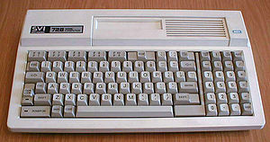
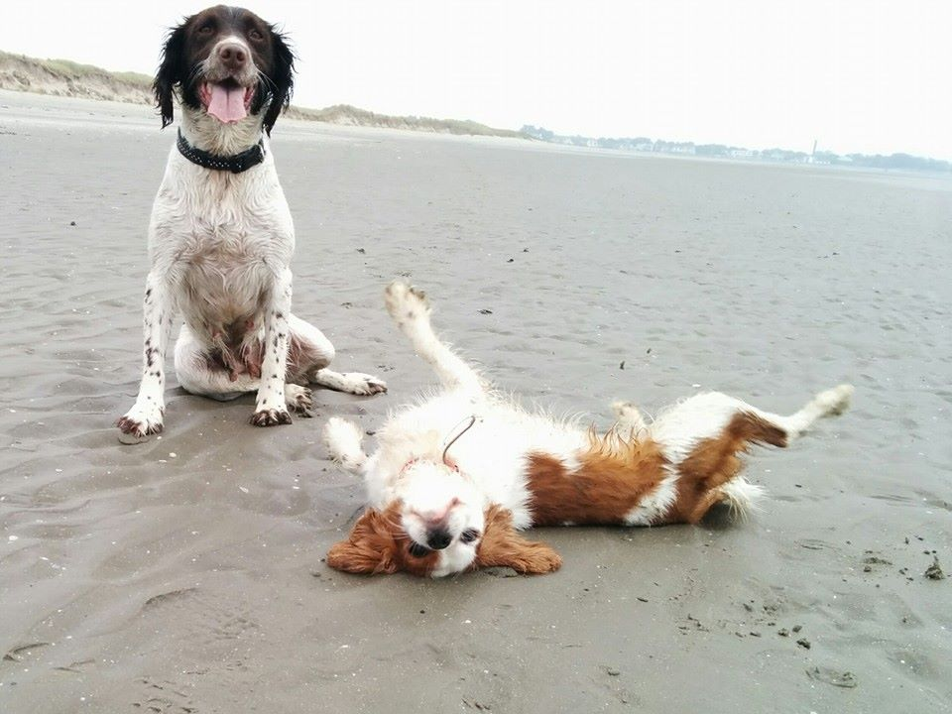
About me
Graduate of DIT!
Teaching for around 15 years
I love programming
Make games, VR & ,music projects
Run game Jams
Gamecraft & DubLUDO
Yoga
Flute
Misty & Tara

Slide 3
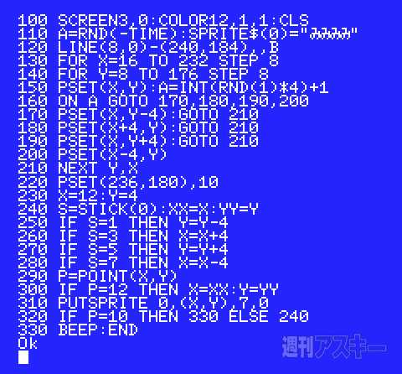
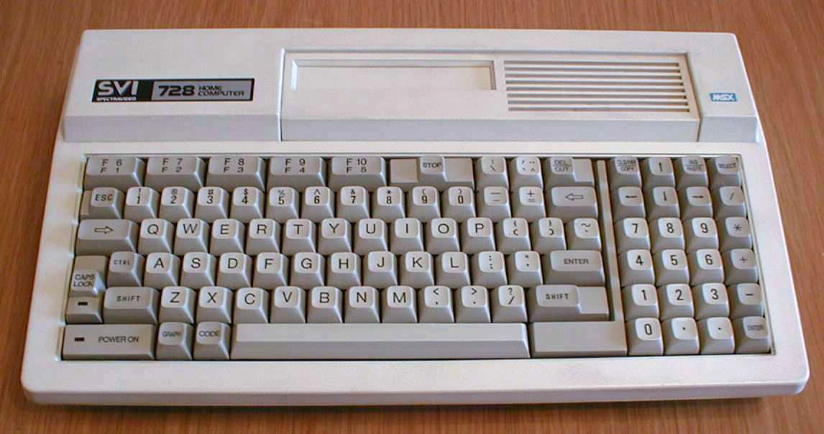

Slide 4
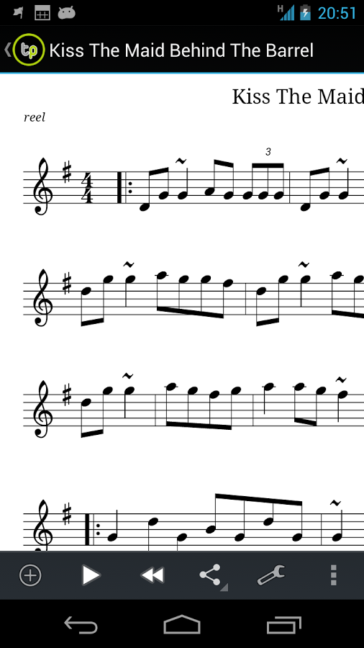
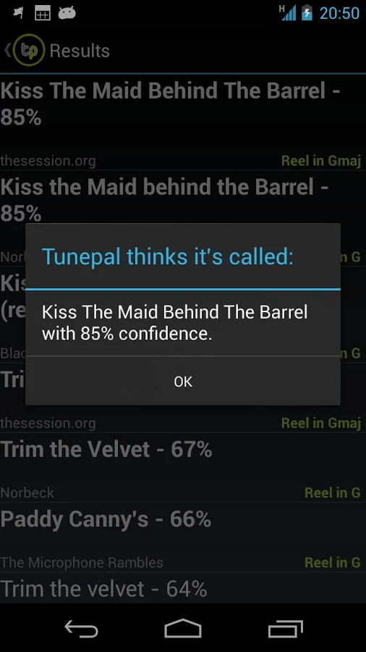

Tunepal
A search-by-playing app for Android and IOS
20K App users
23K music scores
Around 1K music searches per day
> 2 Million searches (70% geotagged)
Links through to YouTube
MIDI Playback ☹

Slide 5

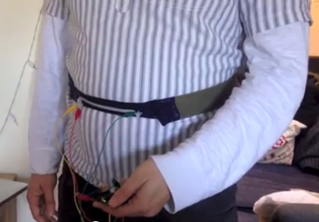

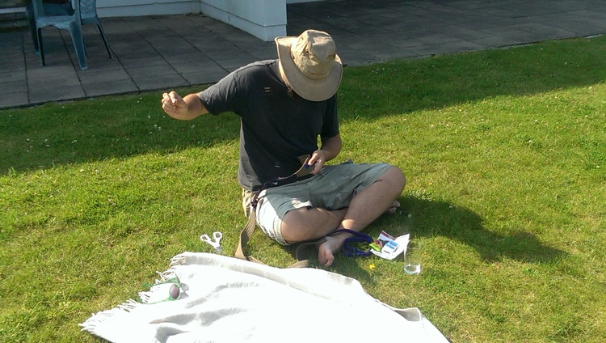
DEEP

Slide 6
Computational Thinking
How to construct solutions to open-ended problems
How to think like a programmer
Variables
Algorithms
Program design

Slide 7
Computational Thinking using Processing – Semester 1
Using variables
Selection
Iteration
Arrays, Strings
Methods
Classes, fields, methods
Constructors
Inheritance
Polymorphism
Interfaces & abstract classes
Design patterns

Slide 8
What is programming?
Whatever you think programming is…
It all boils down to one thing:
Making Stuff

Slide 9
What we will make
Trigonometry
Circles spirals & generative art
Data analysis & visualisation
Conway’s game of life
Spacewars

Slide 10


Slide 11
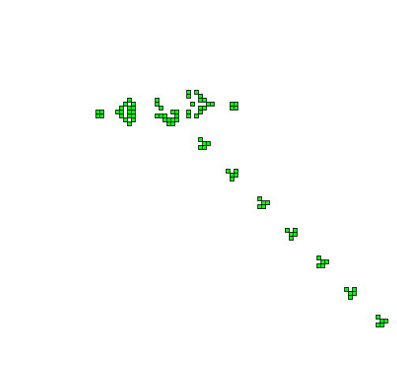

Slide 12
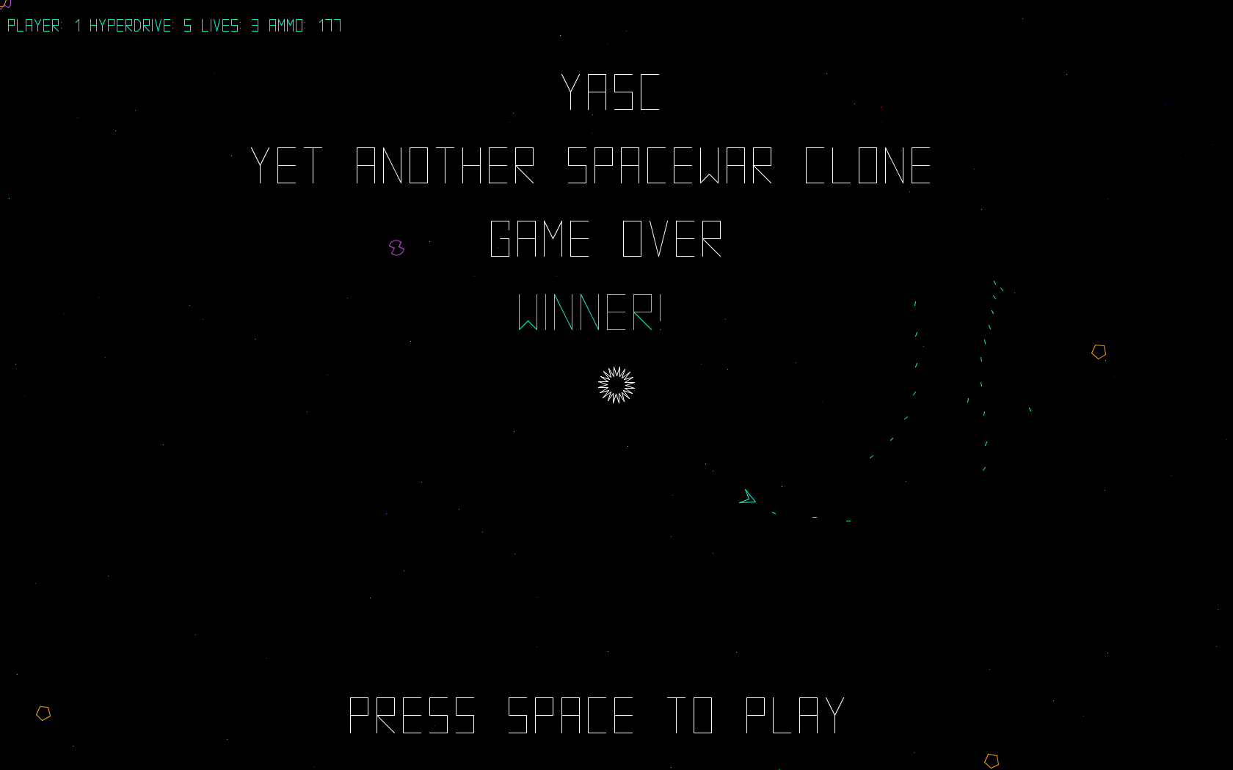

Slide 13
Why Processing?
It is immensely fun, creative, addictive
You can learn programming by making cool stuff
Easier to attain a flow state
You can learn all the important stuff and it is easy to transfer these skills to other frameworks
You will learn & code in lots of different languages in college
You can use Python, C++, Go, Swift whatever you like for your second semester assignment

Slide 14
Flow
Fully immersed in a feeling of energized focus, full involvement, and enjoyment in the process of the activity.
Complete absorption in what one does.
Named by Mihály Csíkszentmihályi, the concept has existed for thousands of years under other guises, notably in some Eastern religions
Achieving flow is often colloquially referred to as being in the zone
Completely focused motivation.
Single-minded immersion
The ultimate experience in harnessing the emotions in the service of performing and learning.
In flow, the emotions are not just contained and channeled, but positive, energized, and aligned with the task at hand.
A feeling of spontaneous joy, even rapture, while performing a task
Deep focus on nothing but the activity – not even oneself or one's emotions.

Slide 15


Slide 16


Slide 17


Slide 18


Slide 19
Semester 2 - Java
Build a full music retrieval system similar to Tunepal using Java & processing
The JDK
Maths library
Member visibility, operations, static & non-static
Dynamic programming
Eclipse
Using Java libraries
Collections framework
Digital signal processing
JDBC
Generics
Inner classes & anonymous inner classes

Slide 20
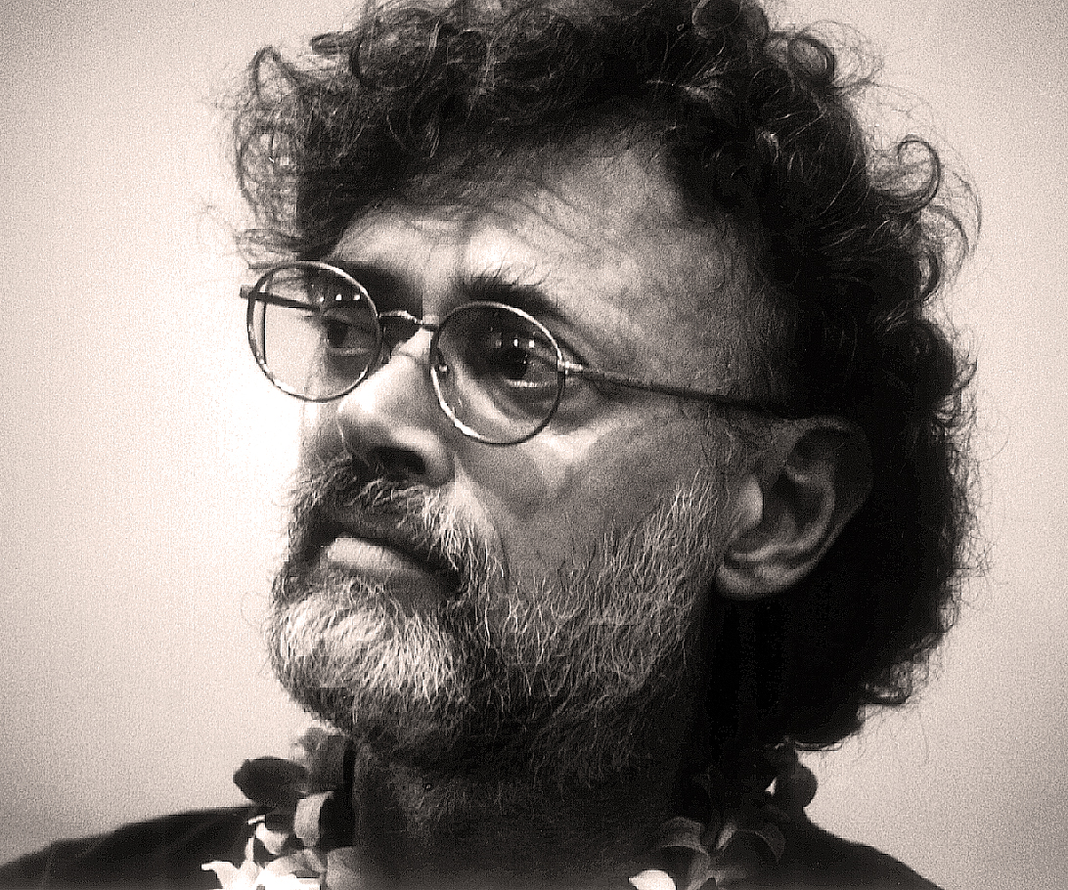
Terence McKenna
Lecture tours and workshops promoting natural psychedelics as a way to explore universal mysteries, stimulate the imagination, and re-establish a harmonious relationship with nature
He was called the "Timothy Leary of the '90s”
Novelty theory and Timewave Zero
The stoned ape theory
Magic mushroom spores from aliens
True Hallucinations
The Invisible Landscape: Mind, Hallucinogens and the I Ching
Felt presence of direct experience

Slide 21
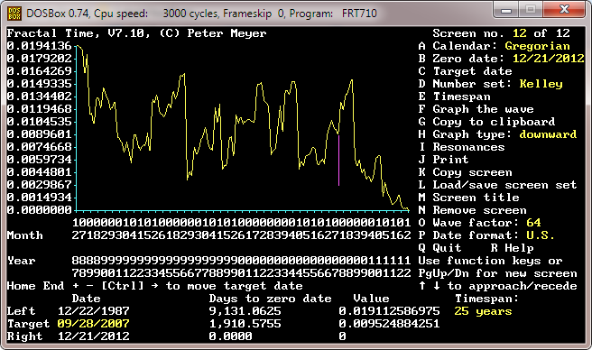

Slide 22
Programming = learning programming
Learning programming = programming

Slide 23
What do we do in the class/labs/tutorials?
In the class on Monday & Tuesday
Everyone brings a laptop/tablet or phone to code on
We will learn a new thing together by making something
I will get us started and then you will build some of it yourself
Programmer yoga
In the tutorial on Friday
Usually an advanced system from the class
I set the problem, you guys code, we come together at the end to compare solution
In the lab
You guys work on a problem by yourself
Take an MCQ at the end

Slide 24
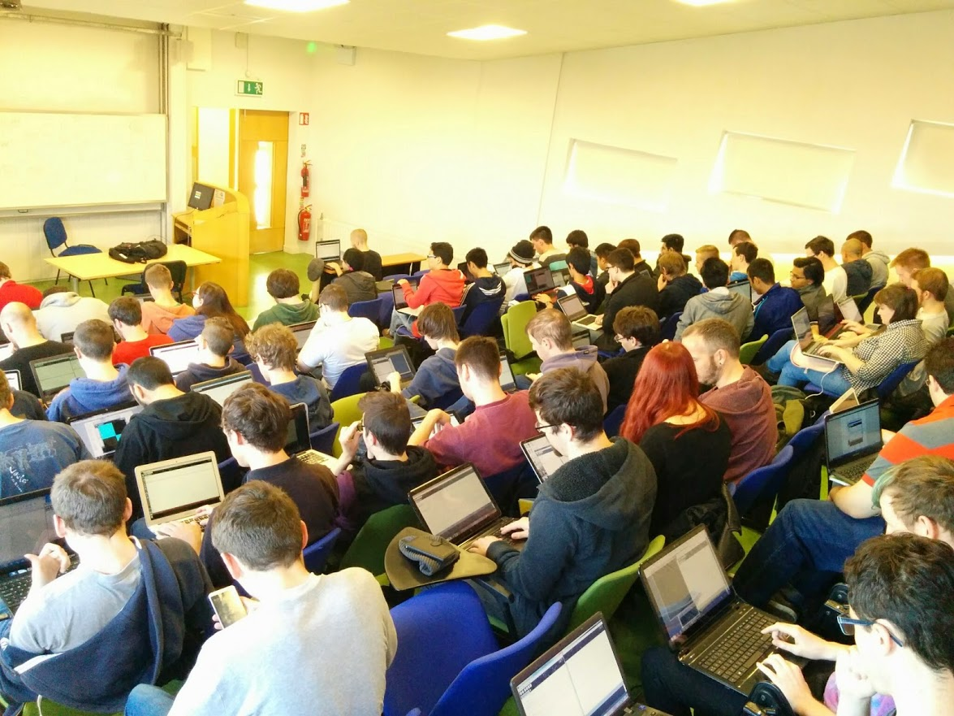

Slide 25
What resources do I need?
Bring a laptop to class!
Processing, Eclipse, git for Windows, SourceTree
Learning Processing book:
http://www.learningprocessing.com/
The Java Tutorial
http://docs.oracle.com/javase/tutorial/
The Nature of Code
http://natureofcode.com/
My YouTube Channel
http://youtube.com/skooter500
The course website
https://github.com/skooter500/OOP-2016-2017

Slide 26
How is the course assessed?
A lab test (Week 6)
A take home assignment (due before Christmas)
Code & a video & readme via github
Weekly MCQ’s
A take home assignment over Christmas
A take home assignment semester 2
Games Fleadh/Imagine Cup are strongly encouraged
Anything you like
Any OO language you like
A blog & a test plan

Slide 27
Your first assignment!
A hud/UI for an upcoming sci-fi movie
You can base it on any movie you like or come up with your own
It should be kinda usable
It should have lots of animation & interactivity
It can be as far out as you like. In other words it can be for an alien

Slide 28
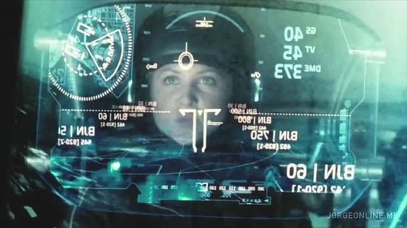


Slide 29
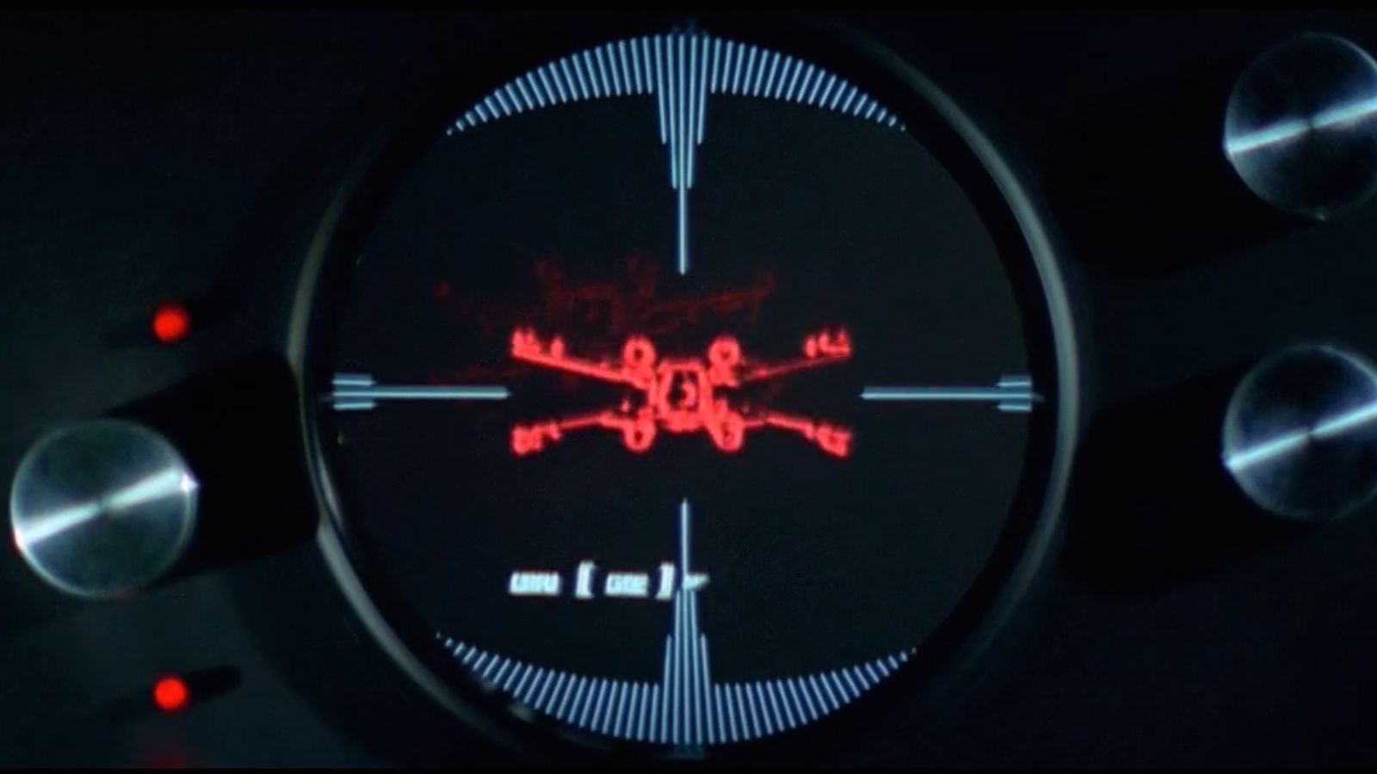

Slide 30
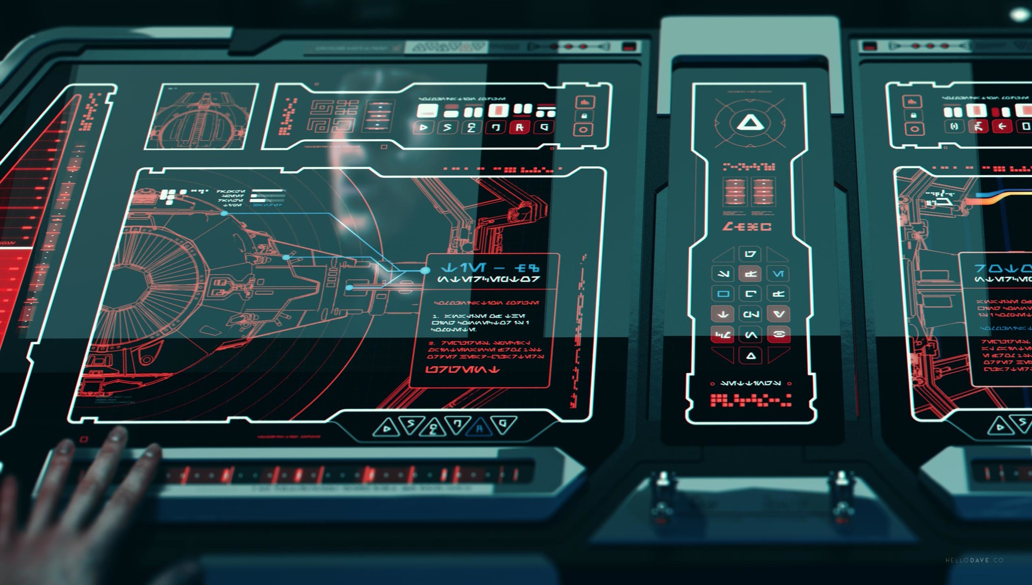

Slide 31


Slide 32
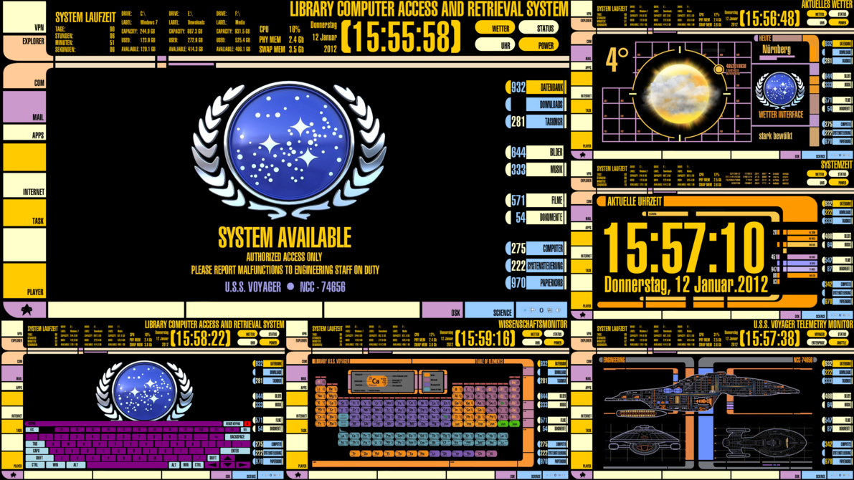

Slide 33
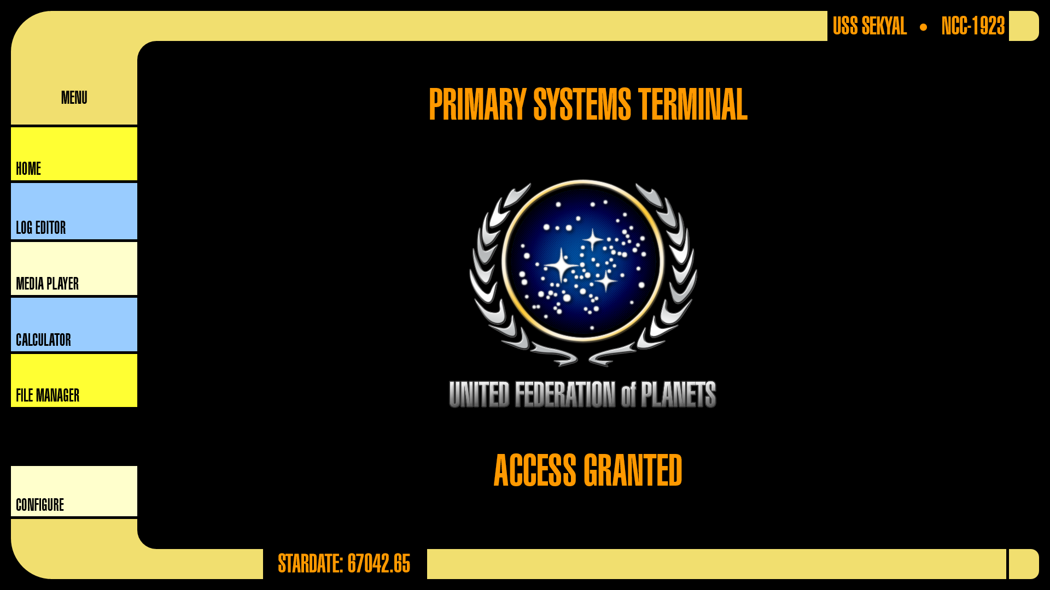

Slide 34
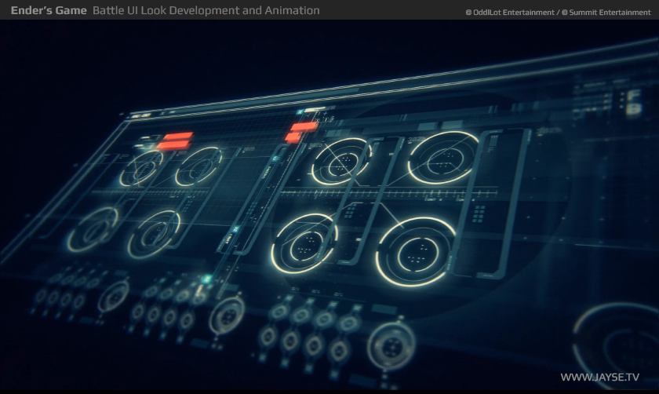

Slide 35


Slide 36
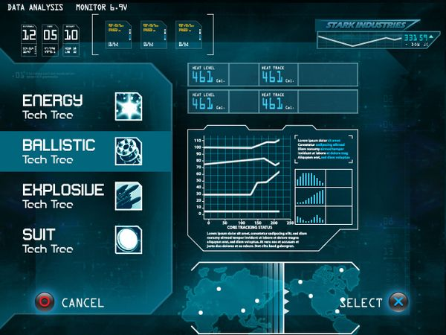

Slide 37
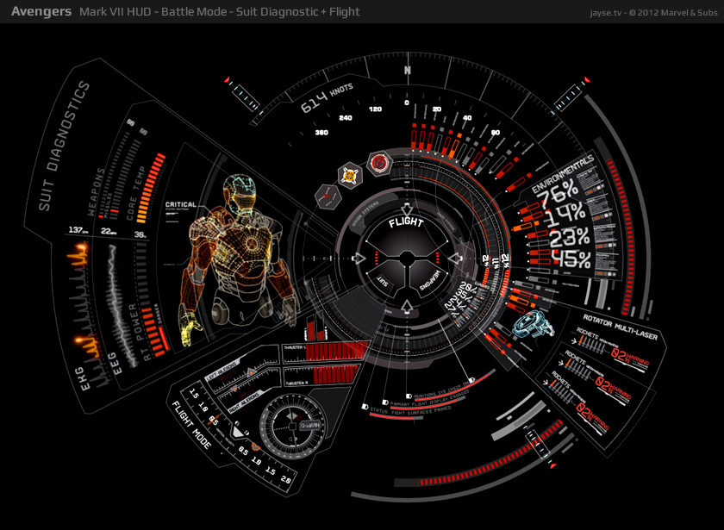

Slide 38
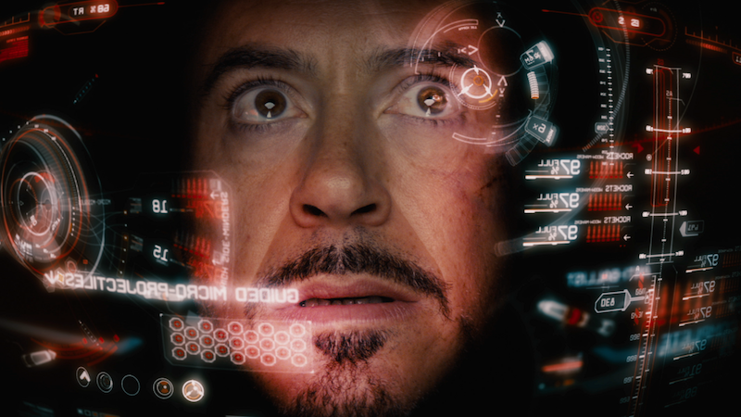

Slide 39
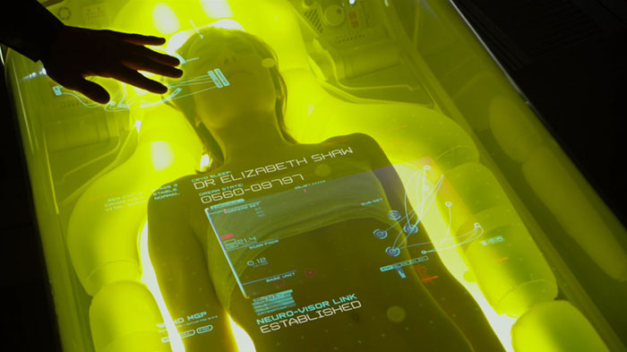

Slide 40


Slide 41
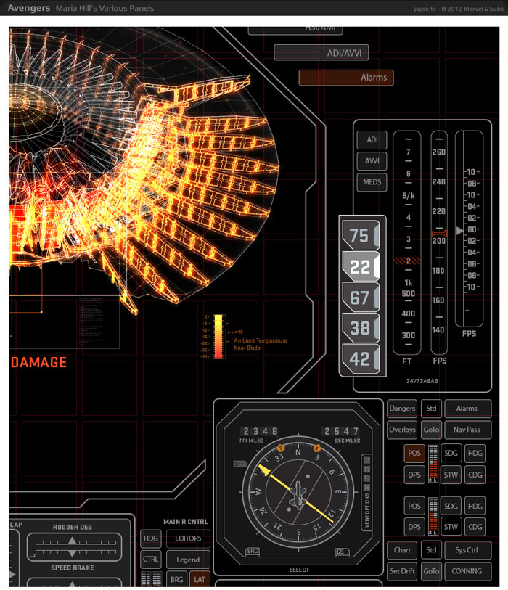

Slide 42
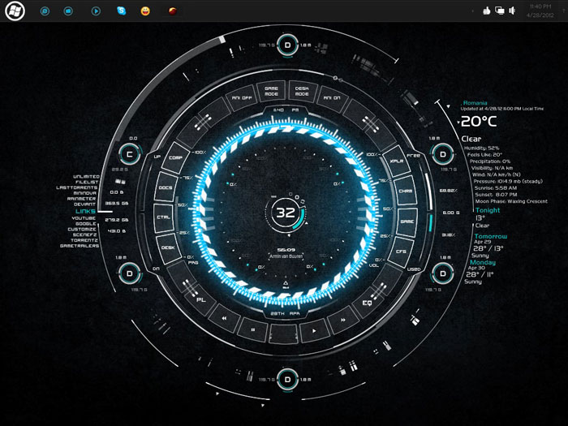

Slide 43
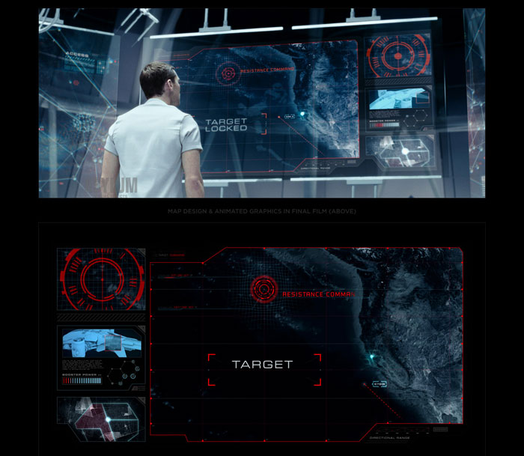

Slide 44
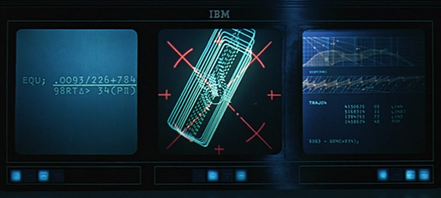
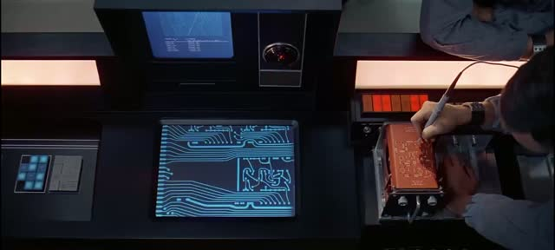

Slide 45
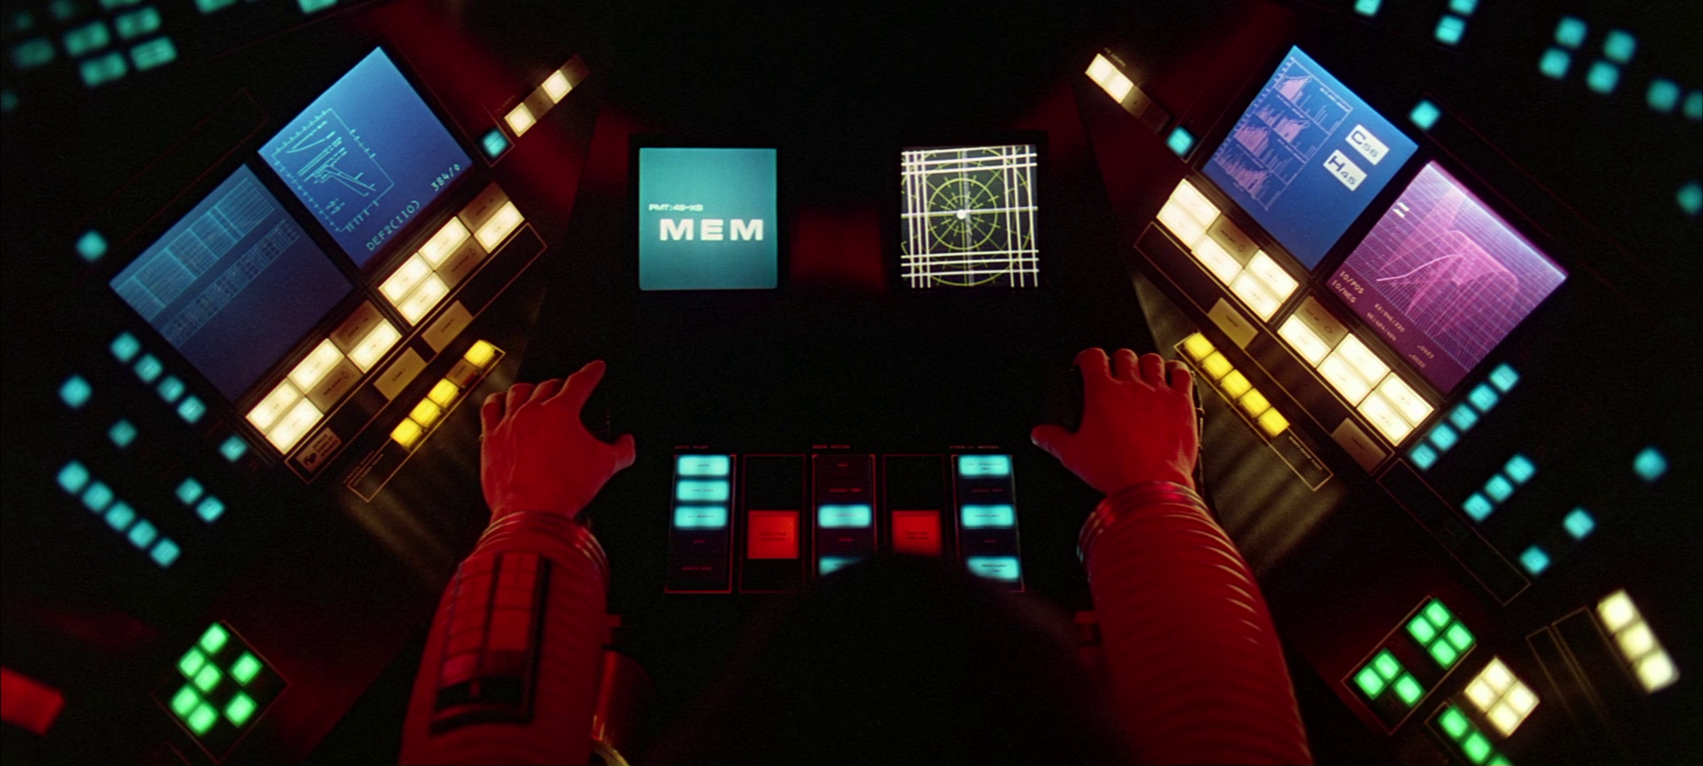

Slide 46
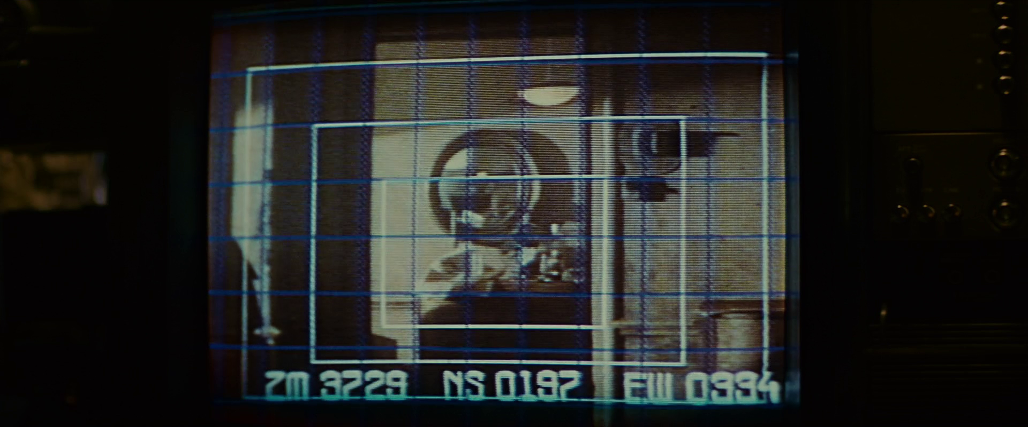

Slide 47
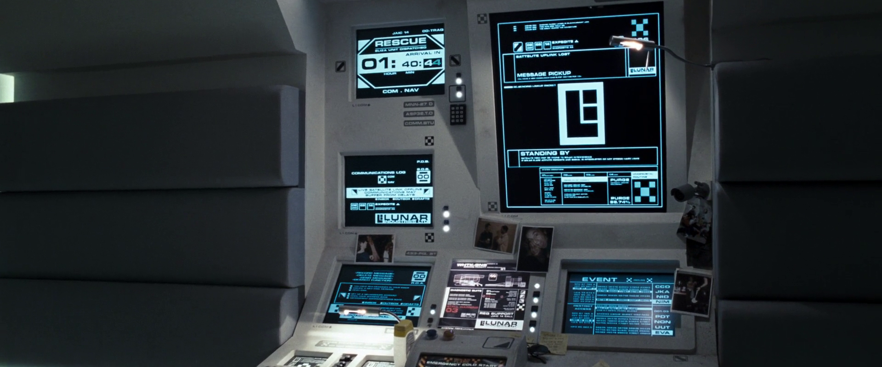

Slide 48


Slide 49
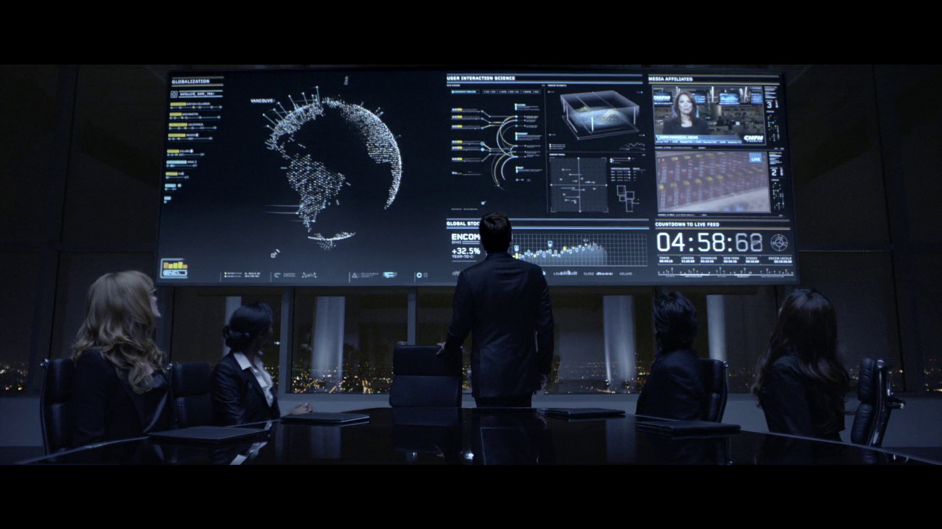

Slide 50


Slide 51
Ideas
A comm system
Navigation
Engines
Console
Weapons systems

Slide 52
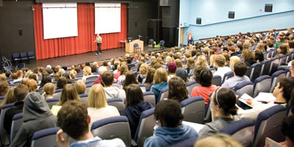
Keep in mind.. NO ONE in the history of programming EVER learned to program in one of these…

Slide 53

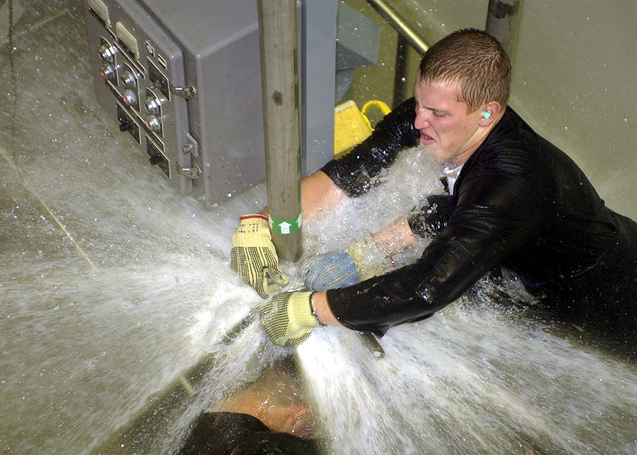
Consider…

Slide 54
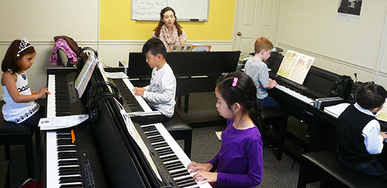
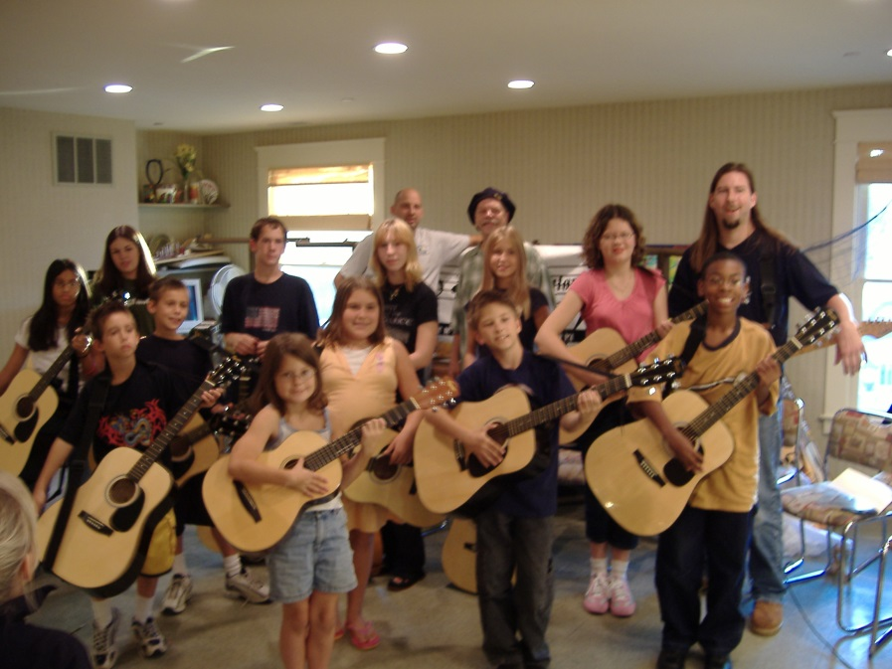
Consider..

Slide 55
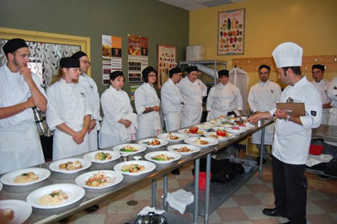
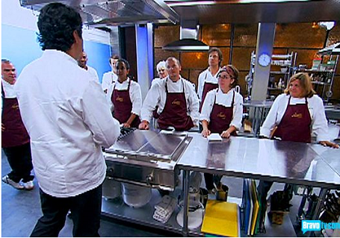

Slide 56
Learn programming
IT WILL
CHANGE YOR LIFE

Slide 57

Data entry clerk
Salary €8 per hour

Slide 58
Programmer
Salary €50 per hour

Slide 59

Really good Programmer
Salary €500 per hour

